Slide 1
Applications of Stacks

Slide 2
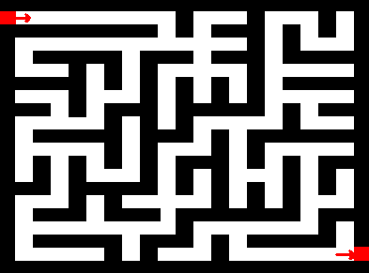
Applications
Reverse a word.
Push a word letter by letter and then pop letters from the stack.
"UNDO" mechanism in text editors.
Backtracking.
Game playing, finding paths, exhaustive searching.
Parsing.
Recursive function calls.
Balanced Parenthesis
Expression Evaluation.
Expression Conversion.

Slide 3
Expression Representation
Infix – Operator is in-between the operands.
Prefix – Operator is before the operands. Also known as polish notation.
Postfix – Operator is after the operands. Also known as suffix or reverse polish notation.
Infix | Prefix | Postfix
a + b | + a b | a b +
a + b * c | + a * b c | a b c * +
(a + b) * (c - d) | * + a b - c d | a b + c d - *

Slide 4
Example (Infix to Postfix)
5 + 3 * 2
5 3 2 * +
3 + 4 * 5 / 6
3 4 5 * 6 / +
( 300 + 23 ) * ( 43 – 21 ) / ( 84 + 7 )
300 23 + 43 21 - * 84 7 + /
( 4 + 8 ) * ( 6 – 5 ) / ( ( 3 – 2 ) * ( 2 + 2 ) )
4 8 + 6 5 - * 3 2 – 2 2 + * /

Slide 5
Infix to Postfix Conversion Algorithm
Let Q be any infix expression to be converted in to a postfix expression P.
Push left parenthesis onto STACK and add right parenthesis at the end of Q.
Scan Q from left to right and repeat step 3 to 6 for each element of Q until the STACK is empty.
If an operand is encountered add it to P.
If a left parenthesis is encountered push it onto the STACK.
If an operator is encountered, then
Repeatedly pop from STACK and add to P each operator which has same precedence as or higher precedence than the operator encountered.
Push the encountered operator onto the STACK.
If a right parenthesis is encountered, then
Repeatedly pop from the STACK and add to P each operator until a left parenthesis is encountered.
Remove the left parenthesis; do not add it to P.
Exit

Slide 6
Input | Stack | Output
A + (B * (C – D) / E)
A + (B * (C – D) / E)) | (
+ (B * (C – D) / E)) | ( | A
(B * (C – D) / E)) | ( + | A
Input | Stack | Output
– D) / E)) | ( + ( * ( | A B C
B * (C – D) / E)) | ( + ( | A
* (C – D) / E)) | ( + ( | A B
D) / E)) | ( + ( * ( – | A B C
(C – D) / E)) | ( + ( * | A B
) / E)) | ( + ( * ( – | A B C D
C – D) / E)) | ( + ( * ( | A B
/ E)) | ( + ( * | A B C D –
E)) | ( + ( / | A B C D – *
)) | ( + ( / | A B C D – * E
) | ( + | A B C D – * E /
 |  | A B C D – * E / +

Slide 7
Infix to Prefix Conversion Algorithm
Reverse the given expression.
Apply algorithm for infix to postfix conversion.
Reverse the expression.

Slide 8
Postfix Evaluation Algorithm
Initialize empty stack
For every token in the postfix expression (scanned from left to right):
If the token is an operand (number), push it on the stack
Otherwise, if the token is an operator (or function):
Check if the stack contains the sufficient number of values
(usually two) for given operator
If there are not enough values, finish the algorithm with an error
Pop the appropriate number of values from the stack
Evaluate the operator using the popped values and push the single result on the stack
If the stack contains only one value, return it as a final result of the
calculation
Otherwise, finish the algorithm with an error

Slide 9
Example
Evaluate 2 3 4 + * 6 –
2 * (3 + 4) - 6 = 8.

Slide 10
 | Input token | Operation | Stack contents (top on the right) | Details
2 3 4 + * 6 – | 2 | Push on the stack | 2
3 4 + * 6 – | 3 | Push on the stack | 2, 3
4 + * 6 – | 4 | Push on the stack | 2, 3, 4
+ * 6 – | + | Add | 2, 7 | Pop two values: 3 and 4 and push the result 7 on the stack
* 6 – | * | Multiply | 14 | Pop two values: 2 and 7 and push the result 14 on the stack
6 - | 6 | Push on the stack | 14, 6
- | - | Subtract | 8 | Pop two values: 14 and 6 and push the result 8 on the stack
 | (End of tokens) | (Return the result) | 8 | Pop the only value 8 and return it
Thapar Universit
y
UCS406 - Data Struc
tures and Algorithms
32

Slide 11
Solve
Convert to equivalent postfix expression: 1. (A-B)*(D/E)
2. A*(B+D)/E-F*(G+H/K) 3. ((p+q)*s^(t-u))
Evaluate the expression 5 6 2+*12 4 /- in tabular form showing stack after every step.

Slide 12
Operator Precedence
( | Highest Lowest
^ | Lowest
*, /
+,-

Slide 13
Balancing parenthesis
One common programming problem is unmatched parenthesis in an algebraic expression.
When parentheses are unmatched, two types of errors can occur:
Opening parenthesis can be missing.
For example, [A+B]/C}
Closing parenthesis can be missing.
For example, {(A+B)/C

Slide 14
Algorithm
The steps involved in checking the validity of an arithmetic expression
1. Scan the arithmetic expression from left to right.
2. If an opening parenthesis is encountered, push it onto the stack.
3. If a closing parenthesis is encountered, the stack is examined.
a. If the stack is empty, the closing parenthesis does not have an opening parenthesis. So the expression is invalid.
b. If the stack is not empty, pop from the stack and check whether the popped item corresponds to the closing parenthesis.
If a match occurs, continue. Otherwise, the expression is invalid.
4. When the end of the expression is reached, the stack must be empty; otherwise one or more opening parenthesis does not have corresponding closing parenthesis. So the expression is invalid.

Slide 15
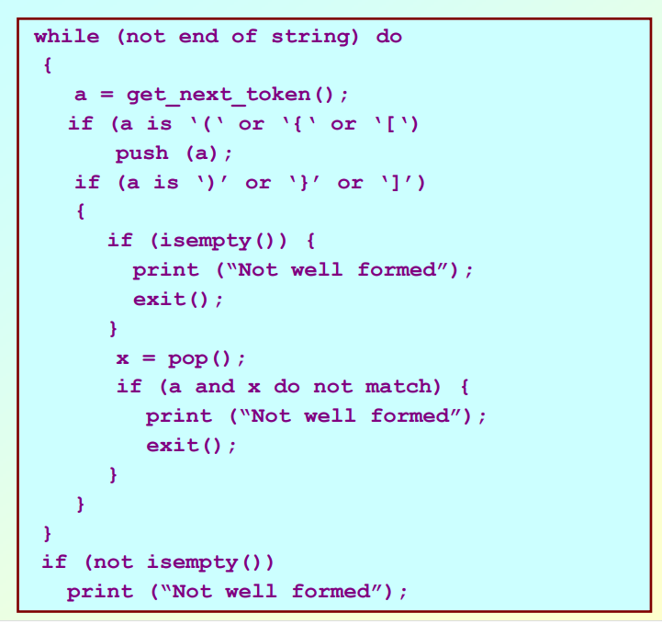

Slide 16
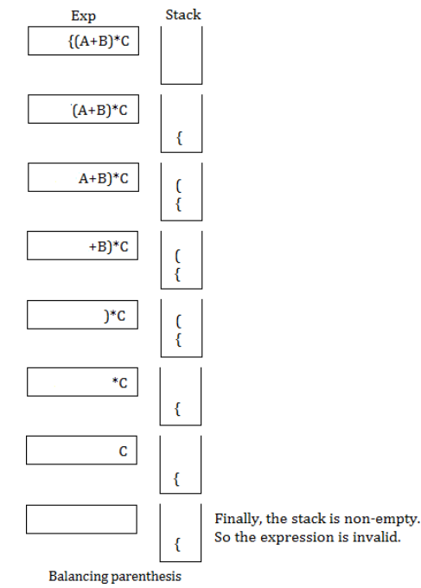
Example

Slide 17
Check whether the given string is Palindrome using Stack
Find the length of the string say len.
Find the mid as mid = len / 2.
Push all the elements till mid into the stack i.e. str[0…mid-1].
If the length of the string is odd then neglect the middle character.
Till the end of the string, keep popping elements from the stack and compare them with the current character i.e. string[i].
If there is a mismatch then the string is not a palindrome. If all the elements match then the string is a palindrome.

